Slide 1
Driver Drowsiness Detection System
A neural network combined with a facial feature extraction module
Team 6
Team members: Tianhan Jiang, Peiyun Zhao, David Laditan, David Guo, Tobi Lawal
Mar 12, 2021

Slide 2
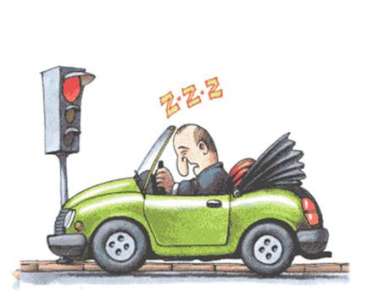
Background - Problem
Drowsy Driving Annually causes:
100,000 vehicle crashes
1,500 deaths
$12.5 billion monetary loss
20% drivers on the road show signs of drowsiness
Notes:
The American National Highway Traffic Safety Administration reports that drowsy driving is related to at least 100,000 motor-vehicle crashes and more than 1,500 deaths per year. The estimated annual monetary loss related is estimated to be about about $12.5 billion.
Drowsiness is identified as one of the major causes of fatal traffic accidents. Unfortunately, about 20% of drivers tend to show drowsiness while driving, reported by National Safety Council^{[1]}.
This project aims to combine a fine-tuned neural network and a python-based face detection and feature extraction module into a real-time drowsiness detection system that will contribute to improving road safety.

Slide 3
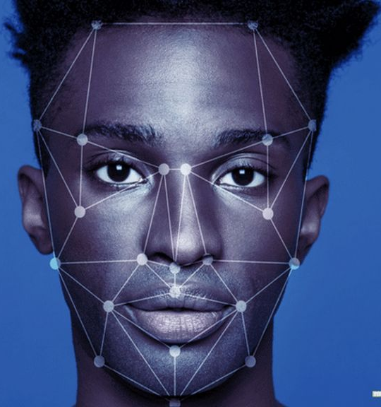
Background - Solution
Current facial expression recognition limits:
75-80% Accuracy
Performance Accuracy
Acceptable: >70%
Outstanding: 75-80%
Notes:
Current state-of-the-art facial expression recognition models can achieve an accuracy of around 75-80%, utilizing the VGG-16 model. Considering that drowsiness detection is arguably easier to differentiate, we would consider an acceptable model performing with 70% validation accuracy and an accuracy greater than 75% being widely successful.

Slide 4

Dataset & Data Preprocessing
2900 images
four labels (balanced):
eyes closed
eyes open
with yawn
without yawn
Notes:
In this stage, we use a kaggle dataset that contains 2900 images with four labels, which are closed, open, no_yawn, and yawn. Those four labels represent human face images with eyes closed, eyes open, without yawn, and with yawn, respectively. The four classes in the dataset are balanced.
In the next stage, we plan to add more image data to the dataset to improve accuracy. If time permits, we might also increase other labels to further categorize the spectrum between drowsy and non-drowsy.

Slide 5
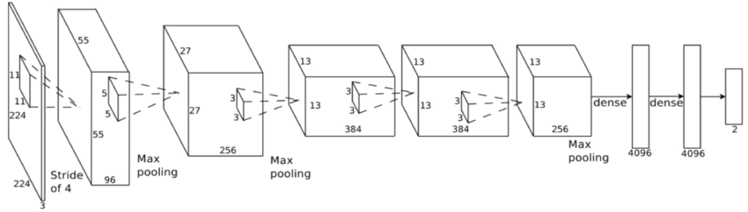
Neural Network Architecture
AlexNet
Notes:
In this stage, we have implemented Alex Net. The result shows a possible overfitting and training time complexity performance is not well. Since other networks are likely to have even deeper architectures than Alex Net, they are likely to return an overfitting result as well.
We decided to build a less complex architecture until more suitable data is found and added on top of our current dataset. This network will also serve as the baseline for all other networks we are going to explore in the next stage

Slide 6
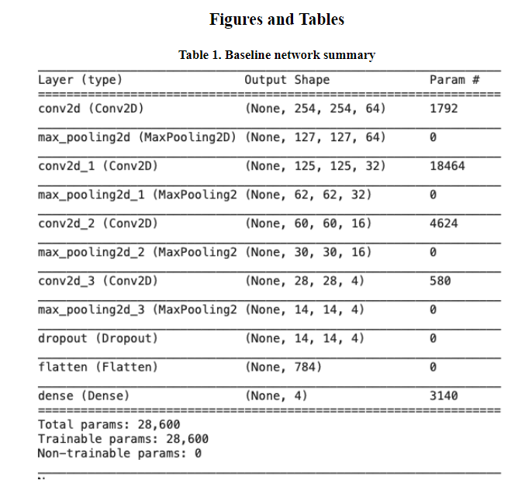
Neural Network Architecture
.
Notes:
The current CNN model has a total of 28,600 trainable parameters and is in the process of further development.
In this model, we use “categorical_crossentropy” to define the loss function and use “accuracy” as the error metric. After 96 epoch, both accuracy and loss tend to flatten. Metrics at epoch 96:

Slide 7
Baseline Model Metrics
 | Training | Testing | Validation
Accuracy | 0.7931 | 0.7875 | 0.7098
Loss | 0.3992 | 0.4176 | 0.4812
Notes:
right now our training accuracy is 0.7931, training loss is 0.3992, test accuracy is 0.7875, test loss is 0.4176, validation accuracy is 0.7098, and validation loss is 0.4812.

Slide 8
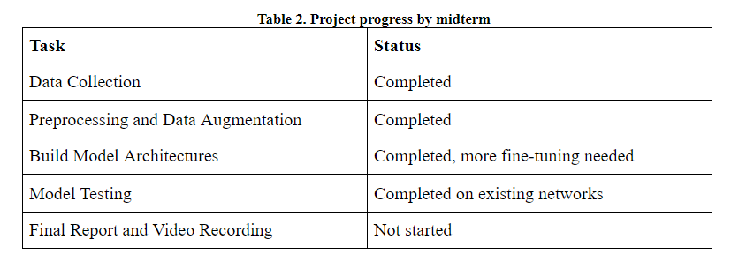
Project Timeline
.
Notes:
Here is our project timeline and our progress so far. We have completed preliminary data collection, preprocessing, and data augmentation.
We have started to explore model architectures and completed model testing on the ones we made so far. However, we would require more fine-tuning to achieve higher accuracy.
We have not started work on the final report and video presentation

Slide 9

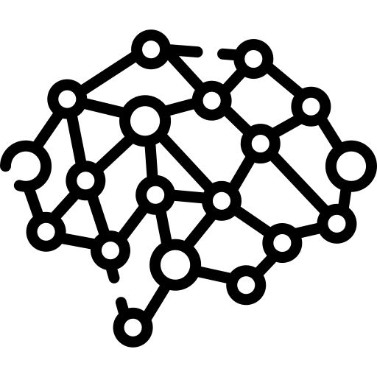
Future Work - Dataset and Networks
Notes:
In the next stage, we may add more image data or implement additional data augmentation to the dataset to improve accuracy. If time permits, we might also increase other labels to further categorize the spectrum between drowsy and non-drowsy.
To train multiple networks separately and ensemble good performing networks to cover all necessary features essential to detect drowsiness

Slide 10
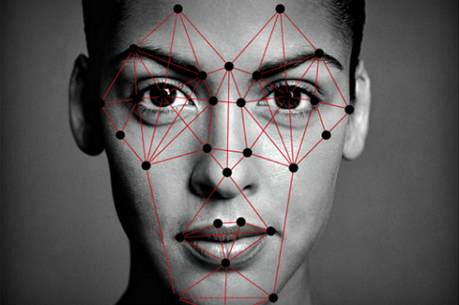
Future Work - Facial Feature Extraction Module
pre processing
extract facial regions separately
Notes:
We plan to implement a python-based module to preprocess all images from the training set, validation set, and test set. This module will be used to perform facial recognition first, keeping only the facial region of the image.
This module will also contain algorithms to extract eye regions and mouth regions separately. For the training set and validation set, either eye feature extraction or mouth region extraction functionality will be used to keep only the region that matches the label. For the test set, or real-time drowsiness detection test, we will use both functionalities to extract both eye and mouth region features and perform classification.

Slide 11

Thank You

